Slide 1

Autonomous Intersection Management (AIM)
By: Team Trier Charles Arsenal Okere(Charles) Muhammad Amirul Hakimi bin Zaprunnizam(Amirul) Muhammad Iqbal bin Mohd Fauzi(Iqbal) Muhammad Farid Izwan bin Mohamad Shabri(Farid) Muhammad Amjad bin Abdul Malik (Amjad)

Slide 2
Problem?
Car crashes at intersection point or junction without traffic controls.
Time wasted
Heavy Traffic

Slide 3
Introduction
We began this research by outlining the most common technology used to solve the problem
Signal optimization with real-time CAV trajectory information
FCFS approach

Slide 4
MOTIVATION
A lot of studies have been done on a wide range of subjects.
Our topic requires us to conduct studies on a certain issue to and to acquire a generative notion about the automation intersection management which allows us to get interested in new ideas and approaches.

Slide 5
Model Design
Activity Diagram
State Chart
Sequence Diagram
Use Case Diagram

Slide 6
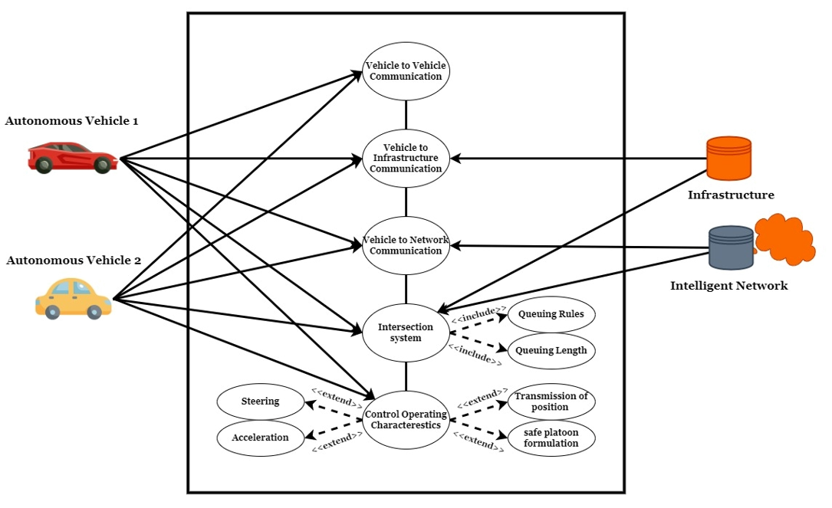
Use Case Diagram
To attain the aim of a totally autonomous driving car, the robot vehicle must have a thorough understanding of its surroundings.
Information that is required is based on onboard sensors which includes
1. Vehicle to Server Hub
2. Vehicle to Intelligent Network

Slide 7
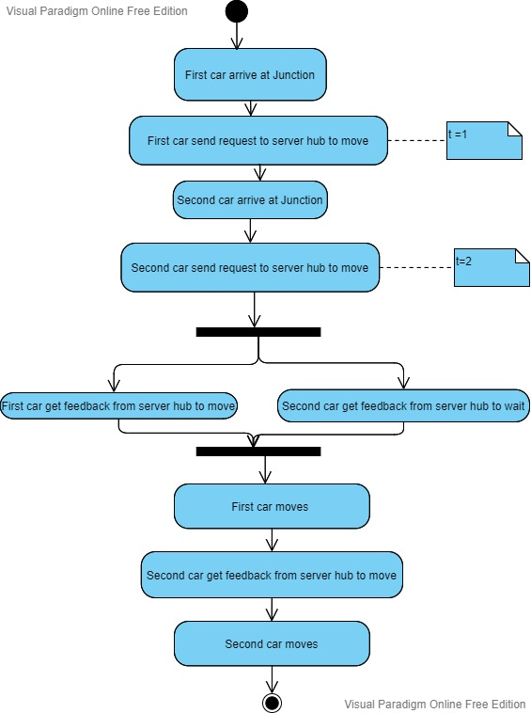
Activity Diagram for car scenario

Slide 8
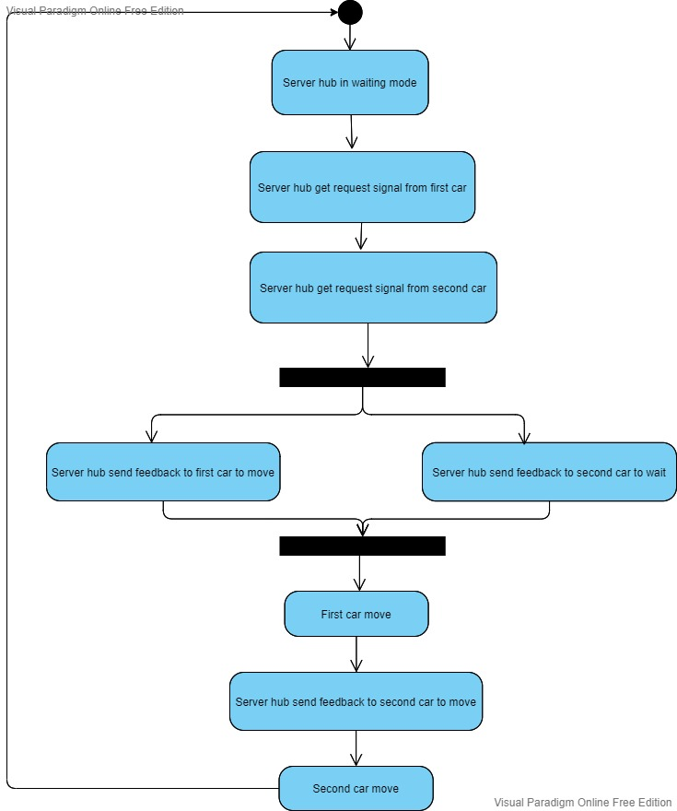
Activity Diagram for server hub

Slide 9
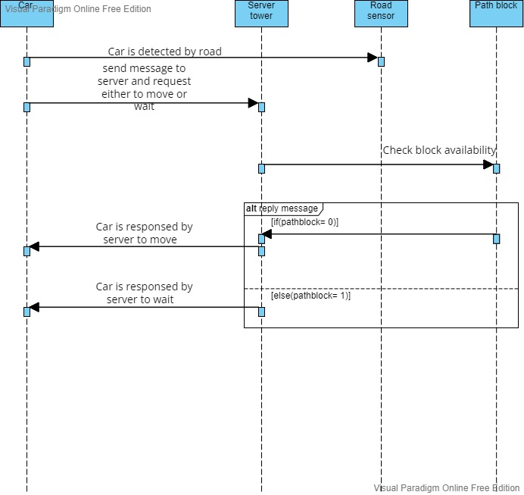
Sequence Diagram

Slide 10
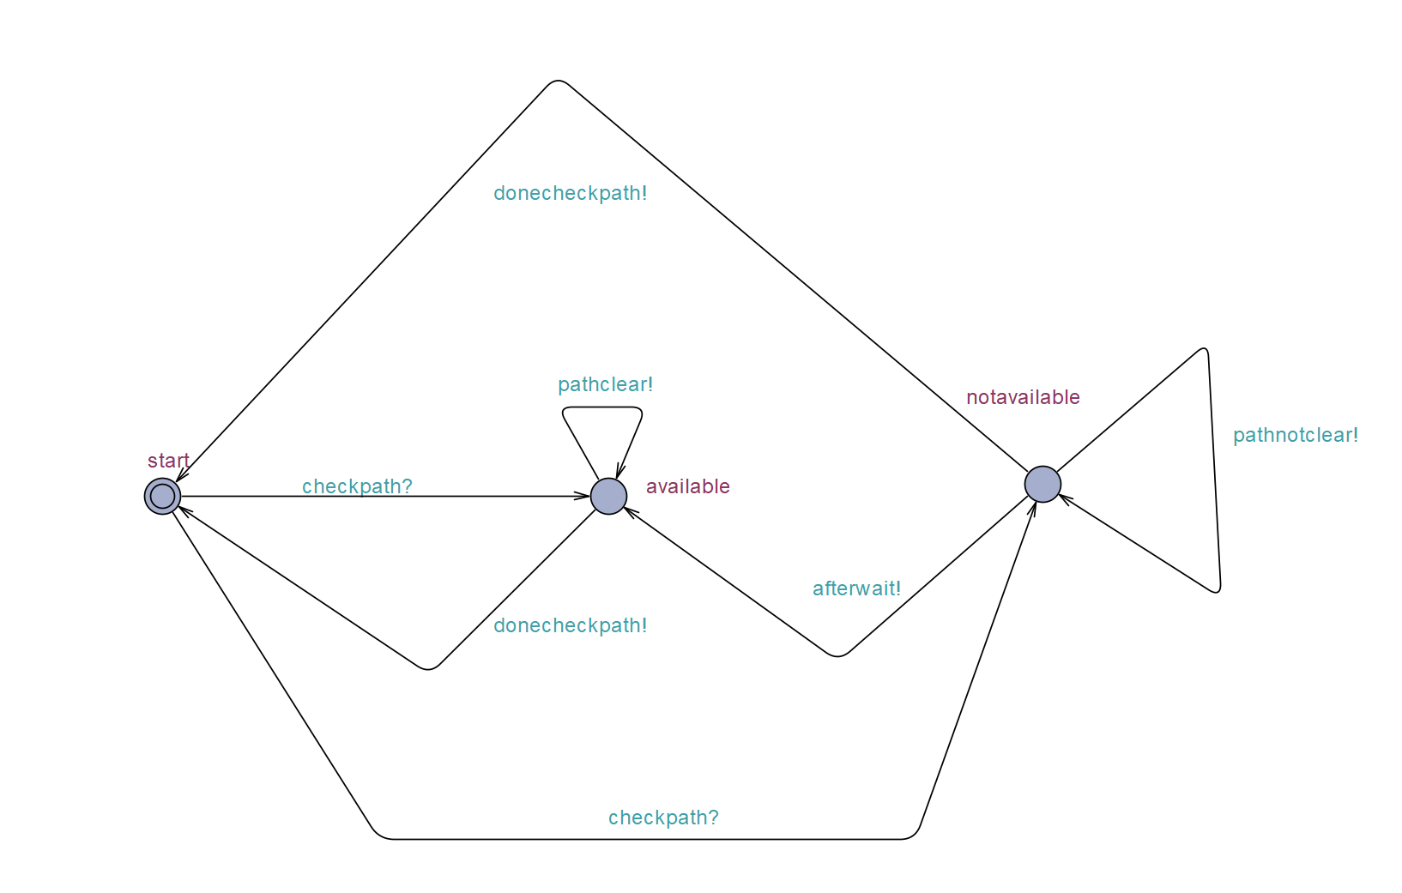
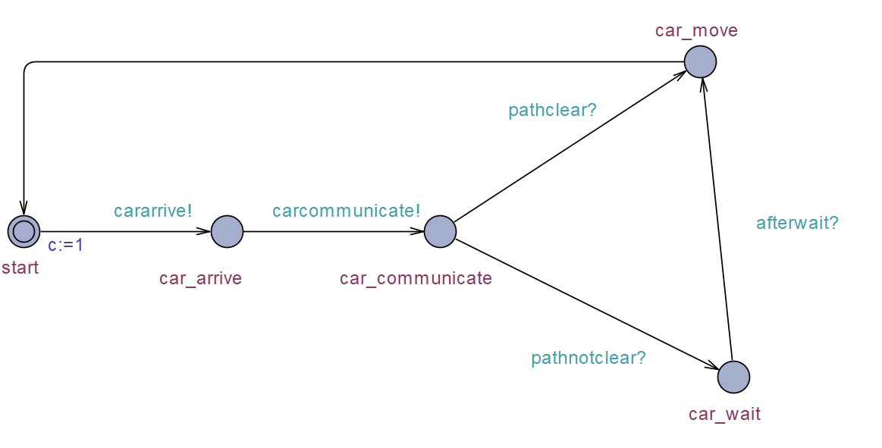
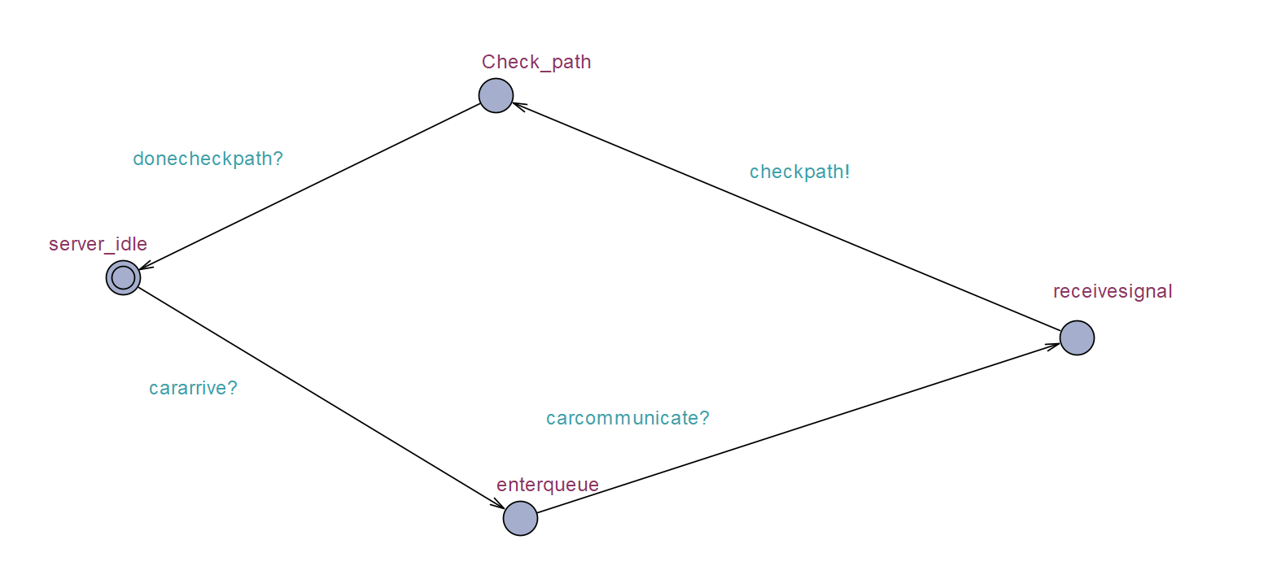
UPPAAL
Car State
Server State
Path State

Slide 11
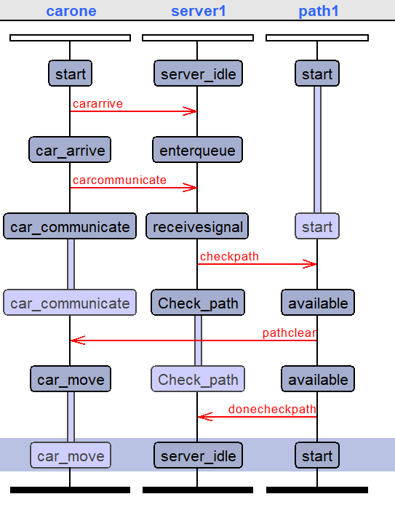
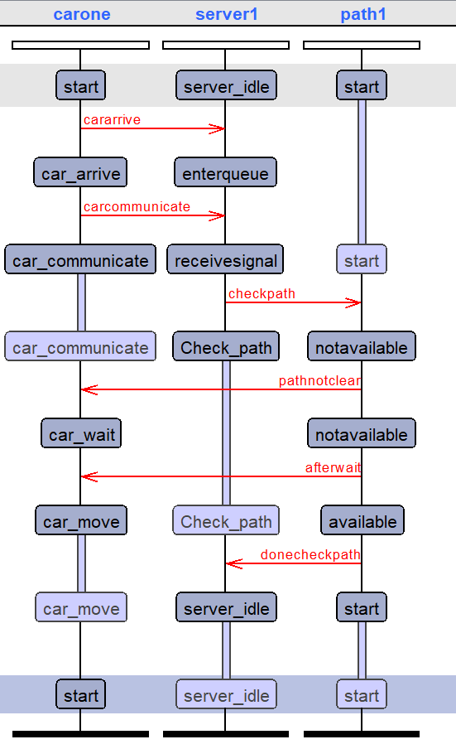
Simulation
Path available
Path not available

Slide 12

Implementation

Slide 13

Real Time Operating System(RTOS)

Slide 14
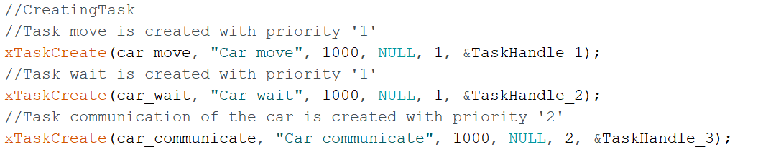
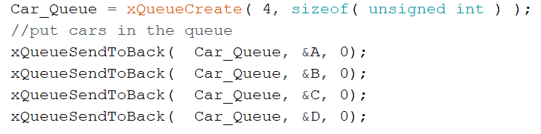
Create Task and Queue
car_communicate = priority “2”
car_wait = car_move = priority “1”
Priority 2 > Priority 1

Slide 15
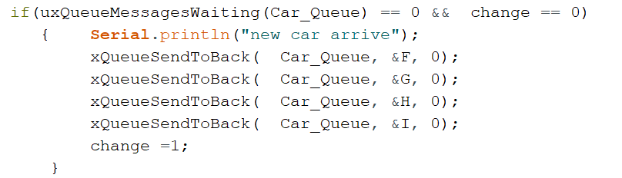
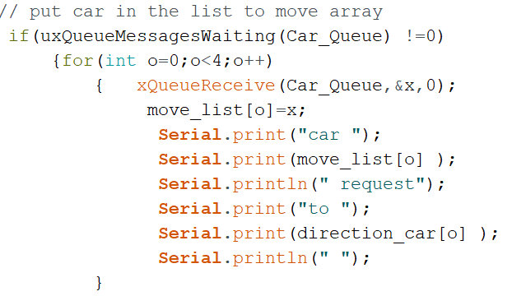
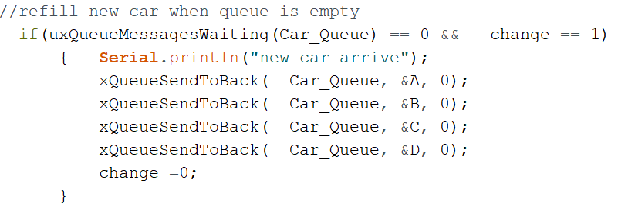
Queue Management
Task Communication

Slide 16
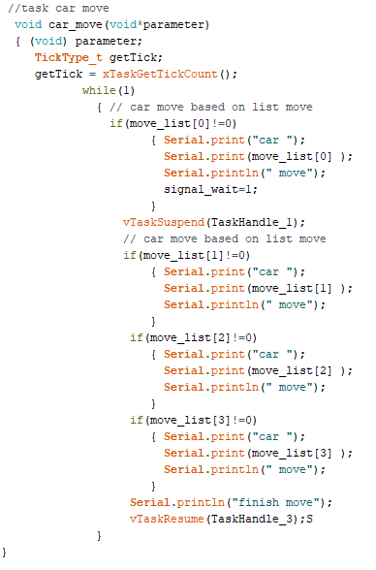
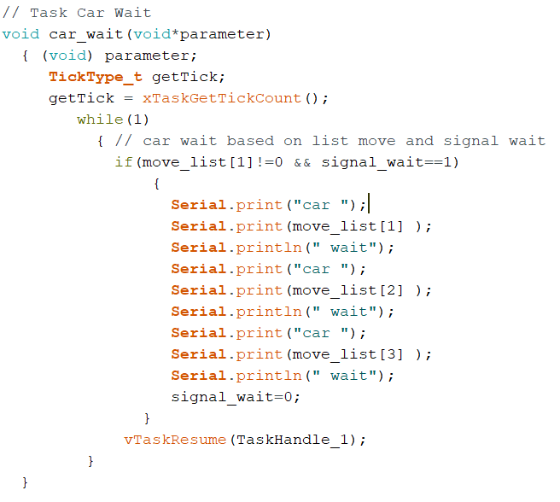
Concurrency

Slide 17
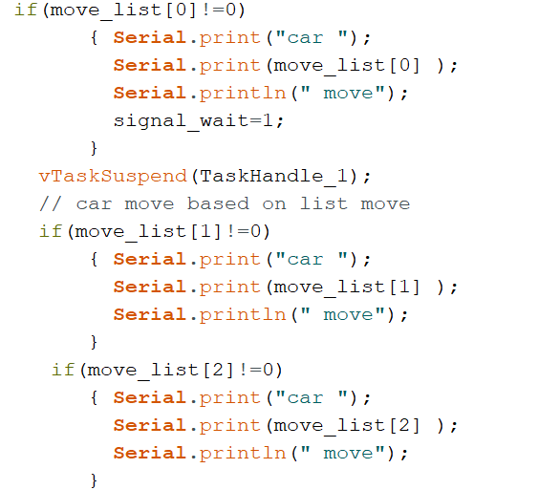
Moving Management
Car Move Task

Slide 18
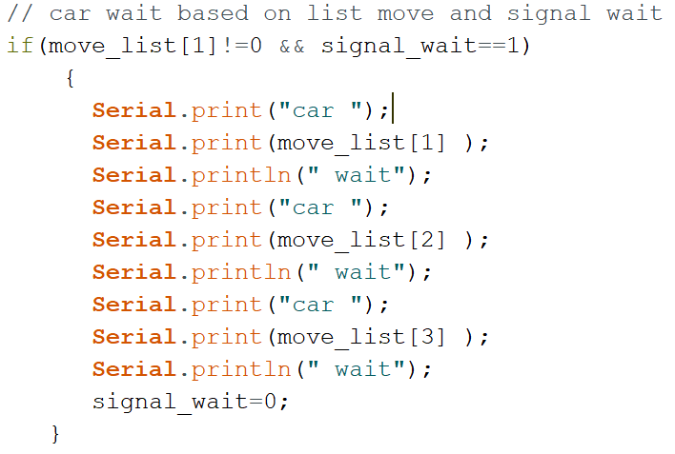
Wait Management
Car Wait Task

Slide 19
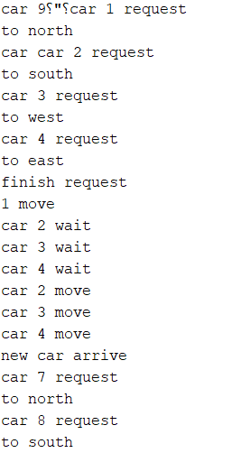
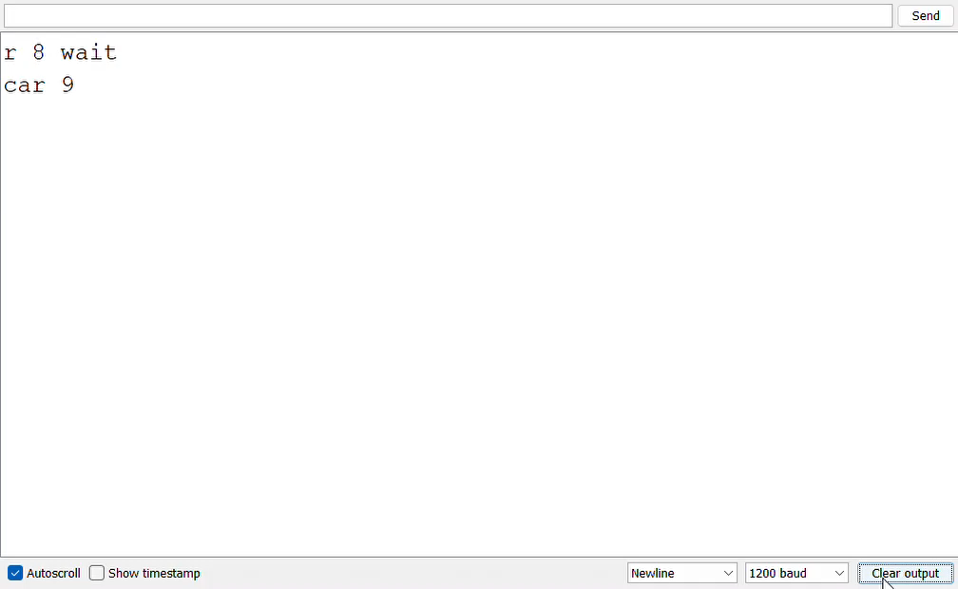
Result

Slide 20

VHDL

Slide 21
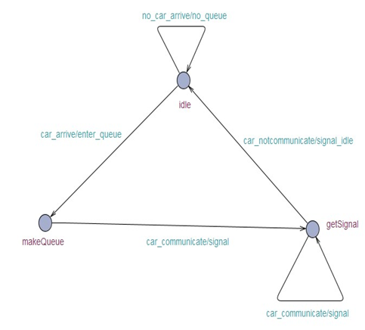
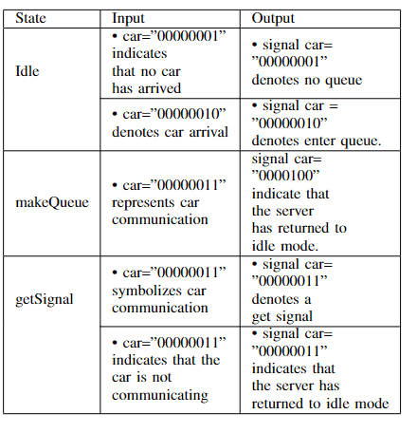
Finite State Machine (FSM)
Communication between car and server
Three state :Idle, makeQueue,getSignal

Slide 22
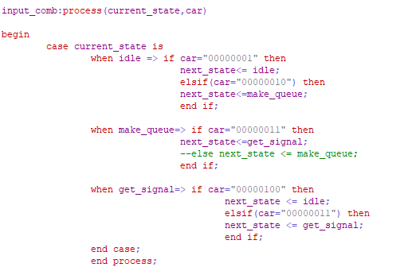
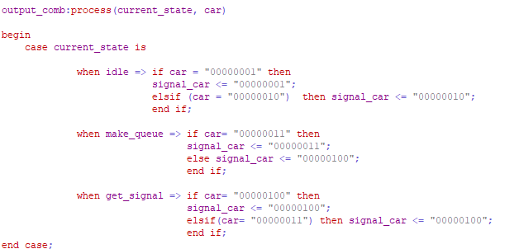
Input and Output

Slide 23
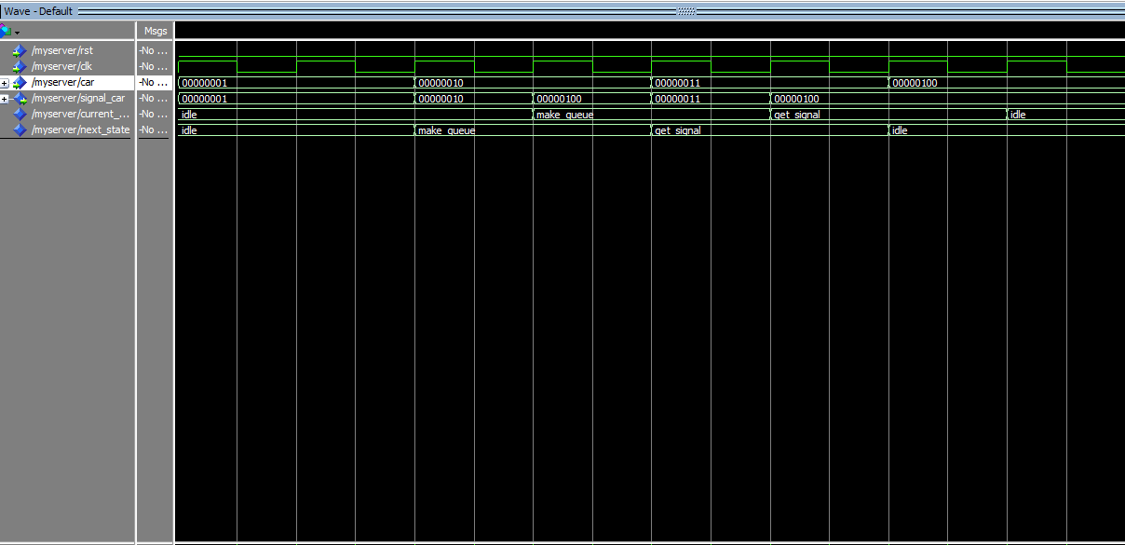
Result

Slide 24
Conclusion
In this project, a simple design model of AIM has fully discussed.
Since there might no traffic light in the future, it is benefit to use it in traffic management such as to avoid accident, heavy traffic, etc. This paper also provides diagrams that explained the structure of our system.

Slide 25
Back Up Slide

Slide 26
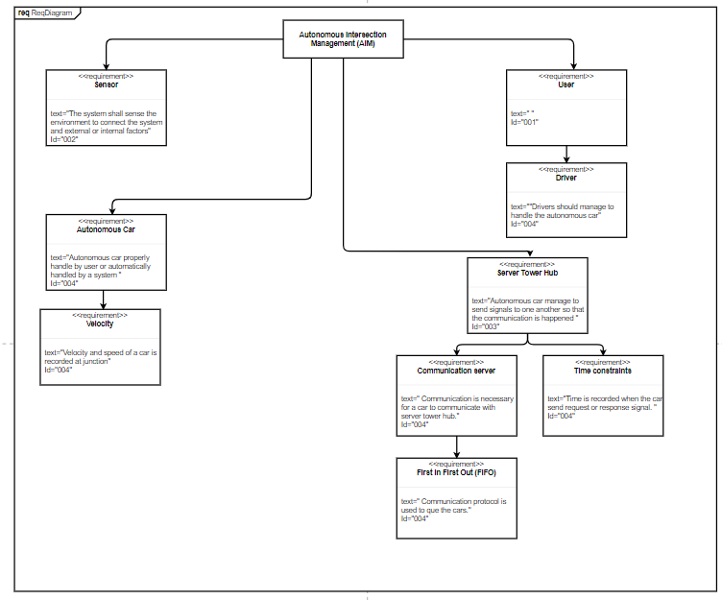
Requirement Diagram

